Slide 1
Business Analytics: Advance
Basics of Data (II)

Slide 2
Recap & Agenda
What is Statistics?
Here,
STATISTICS
Descriptive Statistics
Presenting, organizing and summarizing data
Inferential Statistics
Drawing conclusions about a population based on data observed in sample
Measure of central tendency
Measure of dispersion
Summarizing data

Slide 3
Agenda
Standardization of scores
Normal Distribution
Hypothesis Testing
Basic R codes

Slide 4
Standard Deviation
The Standard Deviation is a measure of how spread out numbers are
When we calculate the standard deviation we find that (generally)

Slide 5
Standard Scores
The number of standard deviations from the mean is also called the "Standard Score", or "z-score". Get used to those words!
So to convert a value to a Standard Score ("z-score"):
•first subtract the mean,
•then divide by the Standard Deviation
•And doing that is called "Standardizing":
•We can take any Normal Distribution and convert it to The Standard Normal Distribution.
Standard Scores

Slide 6
Why Standardize?
It can help us make decisions about our data.
Example:-
•Here are the students results (out of 60 points):
•20, 15, 26, 32, 18, 28, 35, 14, 26, 22, 17
•Most students didn't even get 30 out of 60, and most will fail.
•The test must have been really hard, so the Prof decides to Standardize all the scores and only fail people 1 standard deviation below the mean.
The Mean is 23, and the Standard Deviation is 6.6, and the Standard Scores are:
-0.45, -1.21, 0.45, 1.36, -0.76, 0.76, 1.82, -1.36, 0.45, -0.15, -0.91
•Only 2 students will fail(the ones who scored 15 and 14 on the test)

Slide 7
Data distribution
Data can be "distributed" (spread out) in different ways.
It can be spread out more on the left or to the right or it can be all jumbled up as shown below.

Slide 8
Normal Distribution
But there are many cases where the data tends to be around a central value with no bias left or right, and it gets close to a "Normal Distribution" like in the image
The "Bell Curve" is a Normal Distribution. And the yellow histogram shows some data that follow sit closely, but not perfectly (which is usual).
Many things closely follow a Normal Distribution:
•Heights of people
•Size of things produced by machines
•Errors in measurements
•Blood pressure
•Marks on a test

Slide 9
Normal Distribution
The Normal Distribution has:
•mean=median=mode
•symmetry about the centre
•50% of values less than the mean and 50% greater than the mean

Slide 10
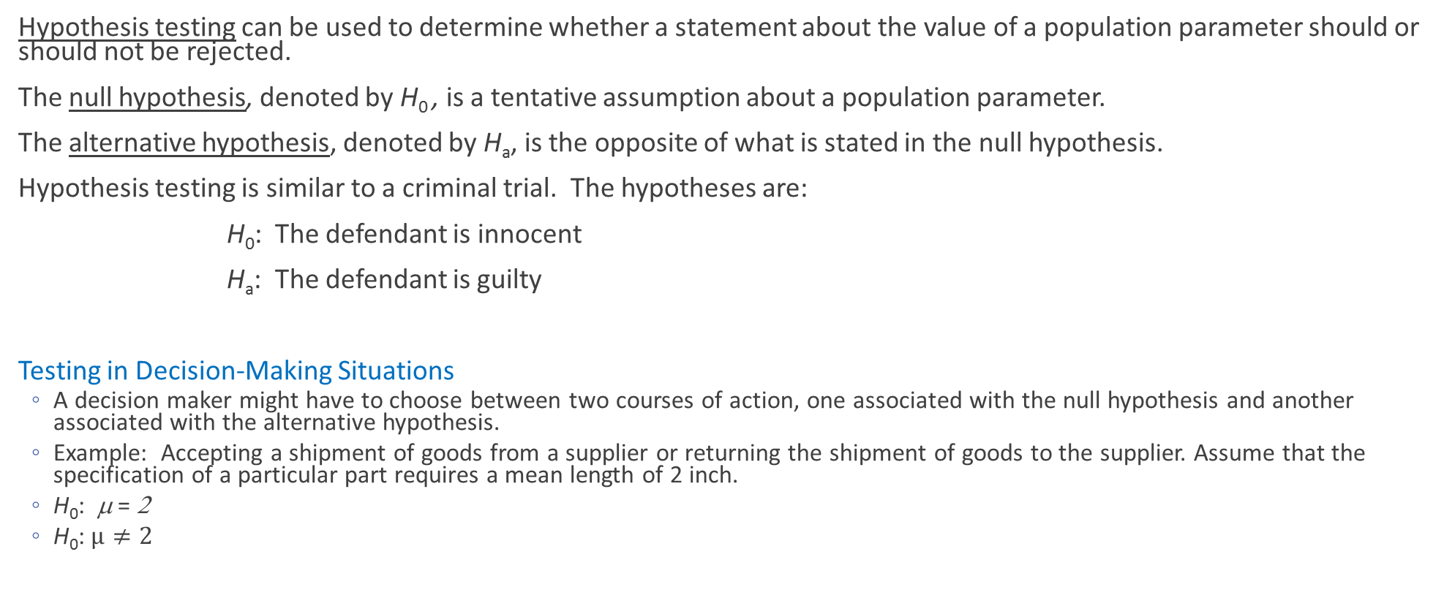
Developing Null and Alternative Hypotheses
Hypothesis testing can be used to determine whether a statement about the value of a population parameter should or should not be rejected.
The null hypothesis, denoted by H₀ , is a tentative assumption about a population parameter.
The alternative hypothesis, denoted by H_{a}, is the opposite of what is stated in the null hypothesis.
Hypothesis testing is similar to a criminal trial. The hypotheses are:
H₀: The defendant is innocent
H_{a}: The defendant is guilty
Testing in Decision-Making Situations
A decision maker might have to choose between two courses of action, one associated with the null hypothesis and another associated with the alternative hypothesis.
Example: Accepting a shipment of goods from a supplier or returning the shipment of goods to the supplier. Assume that the specification of a particular part requires a mean length of 2 inch.
H₀: μ = 2
$\text{H}\text{0}\text{: }μ≠2$

Slide 11
Example: Metro EMS
Null and Alternative Hypotheses
A major west coast city provides one of the most comprehensive emergency medical services in the world. Operating in a multiple hospital system with approximately 20 mobile medical units, the service goal is to respond to medical emergencies with a mean time of 12 minutes or less.
The director of medical services wants to formulate a hypothesis test that could use a sample of emergency response times to determine whether or not the service goal of 12 minutes or less is being achieved.

Slide 12
Example: Metro EMS
Null and Alternative Hypotheses
Hypotheses Conclusion and Action
H₀: μ < 12 The emergency service is meeting
the response goal; no follow-up
action is necessary.
H_{a}: μ > 12 The emergency service is not
meeting the response goal;
appropriate follow-up action is
necessary.
Where: μ = mean response time for the population
of medical emergency requests.

Slide 13
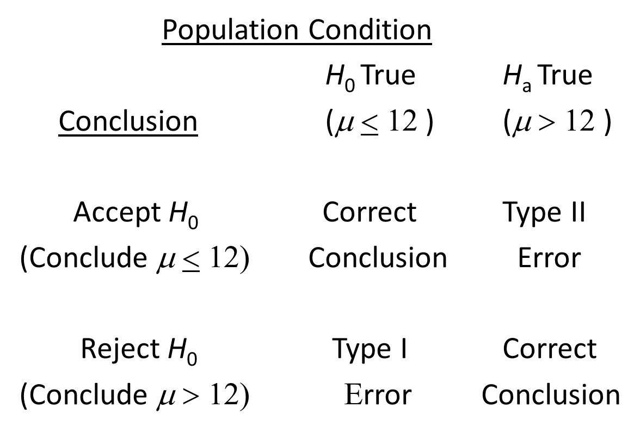
Example: Metro EMS
Type I and Type II Errors

Slide 14
Example: Metro EMS
One-Tailed Test about a Population Mean
Let α = P(Type I Error) = .05
Sampling distribution
of (assuming H₀ is
true and µ = 12)
Reject H₀
Do Not Reject H₀
α = .05
1.645σ
12
c
(Critical value)

Slide 15
Example: Metro EMS
Let n = 40, = 13.25 minutes, s = 3.2 minutes
(The sample standard deviation s can be used to
estimate the population standard deviation σ.)
Since 2.47 > 1.645, we reject H₀.
Conclusion: We are 95% confident that Metro EMS is not meeting the response goal of 12 minutes;
appropriate action should be taken to improve service.

Slide 16
Example: Metro EMS
Using the p-value to Test the Hypothesis
Recall that z = 2.47 for = 13.25. Then p-value = .0068.
Since p-value < α, that is .0068 < .05, we reject H₀.

Slide 17
Two-Tailed Test about a Population Mean
_{Hypothesis:}
H₀: μ = μ₀
H_{a}: μ =^ μ₀
Do Not Reject H₀
Reject H₀
Reject H₀
α /2= .025
α /2= .025
z
-1.96
0
1.96

Slide 18
Introduction to R
What is R?
R is a programming language and software environment for statistical computing and graphics supported by the R Foundation for Statistical Computing.
The R language is widely used among statisticians and data miners for developing statistical software and data analysis.
It is being used by a growing number of data analysts inside corporations and academia.
Why R and not other general purpose languages?
Data mining algorithms can be developed in C / C++ / Java / MATLAB, but for data science R is more convenient i.e. flexible and easy to use language.
The main issue is that it (C++ / Java) has no vectorised operations, so you need to write lots of loops. R is a better choice.
In R, there are libraries that gives solid foundation for all numerical, statistical and matrix computations free of charge

Slide 19
Accomplishments today!
Standardization of scores
Normal Distribution
Hypothesis Testing
Basic R codes

Slide 20
Thank You!

